Slide 1
RELIABILITY
October 2023
9th - 12th

Slide 2
Definition:
The ability to be trusted to do or provide what is needed.

Slide 3
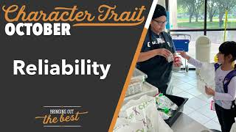

Slide 4
Interactive Activity
Choose one of the following activities below to complete the checklist on the next slide:
Four Corners
Crossing the line
Raise your hand
Notes:
4 Corners: Label the 4 corners of your room: Always, Sometimes, Rarely, Never. Read each statement on the Reliability Checklist and have students go to the appropriate corner.
Crossing the Line: Make an imaginary line down the middle of the room, have all students stand up, read each statement on the Reliability Checklist, and have students move to one side of the line if they are reliable with that task and on the other side of the line if they are not.
Raise Your Hand: Have students raise their hand if they are reliable with each task.

Slide 5
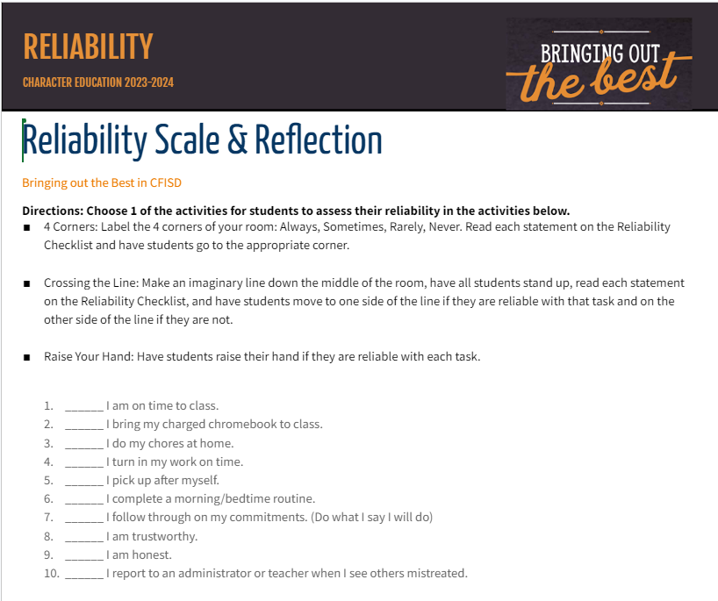
Reliability Checklist
Notes:
Picture is linked to hard copy of the checklist.
Link: https://docs.google.com/document/d/127lRvY8KFgIaRZ1i0ZJv8E8rsdkITAScnqicFW5OTiU/edit?usp=sharing

Slide 6
Reflection Activity
Think about the following questions then discuss:
Were you surprised at your level of reliability or that of your classmates?
What are ways you can improve your reliability?
How do you feel when others are not reliable? Examples: school work graded timely, absent group work partners, incorrect food orders, people keeping their word, etc.

Slide 7
Home Connection
Students will:
Pick an area of personal reliability in which they would like to see growth.
Write down some ideas on things they can do differently to achieve their goal.
Track progress throughout the month and see what positive changes happen.
Revisit the goal at the end of the month.
Notes:
Area refers to personal behavior. Examples: bring charged chromebook, attendance, completing assignments, chores, etc

Slide 8
Reinforcement of Reliability
Encourage staff and students to circle back to theme at the end of the month to check for positive changes.
PBIS points
Class period competitions
Notes:
Announcements throughout month reminding staff and students of the word
Reliability contest between classes, attendance, communication, turning in work on time

