Slide 1
Reliability
October 2023
PK-2nd Grade

Slide 2
Reliability

Slide 3
Reliability
DEFINE
Bringing Out the Best October 2023
APPLY
Students will define reliability.
Students will demonstrate reliability in the classroom, the cafeteria, the bathroom, and the hallway.
IDENTIFY
Students will identify examples of reliable behavior.

Slide 4
Reliability
The ability to be trusted to do or provide what is needed

Slide 5
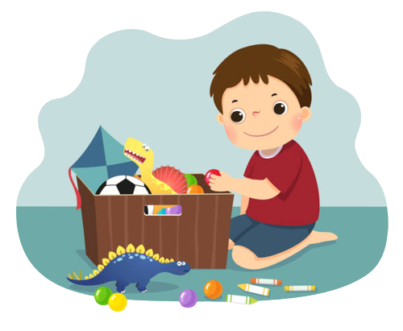
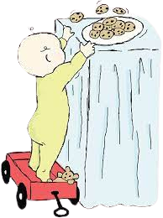
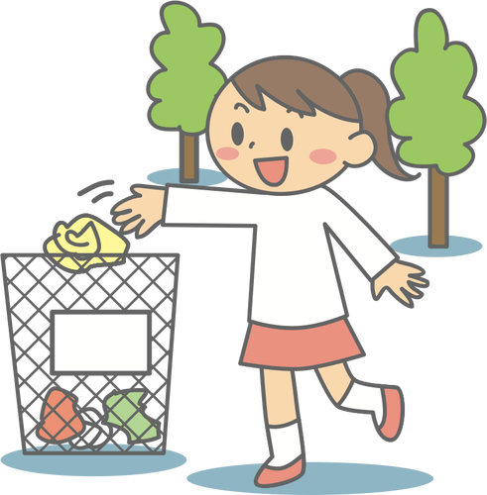
Circle the pictures that show reliability
Cleaning up after yourself
Taking things without asking
Throwing trash away

Slide 6
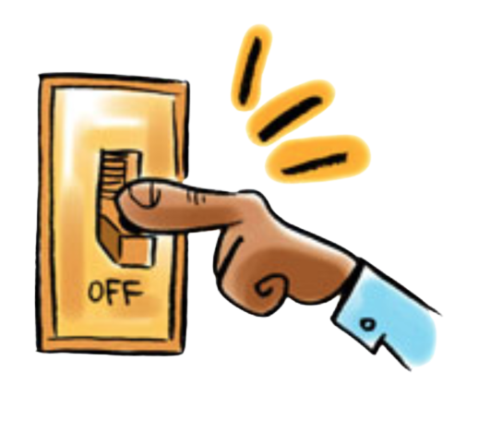
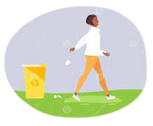
Circle the pictures that show reliability
Turning off the lights when you leave a room
Being prepared for school
Throwing trash on the ground

Slide 7
Write or draw how to show reliability in…..
The classroom
The cafeteria
The bathroom
The hallway

Slide 8
How will you show that you are reliable this week?

Slide 9
HOME ACTIVITY: Write or draw how to show reliability in…..
The kitchen
The living room
Your room
The backyard

