Slide 1
Courtesy
March 2024
PK-2nd

Slide 2
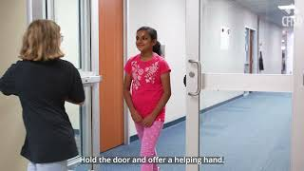

Slide 3
Courtesy
Define
Identify
Apply
Students will define courtesy.
Students will identify ways to show courtesy.
Students will discuss how to show courtesy in different scenarios.

Slide 4
Courtesy
Polite behavior that shows respect for others

Slide 5
How do you show courtesy for others?
?

Slide 6
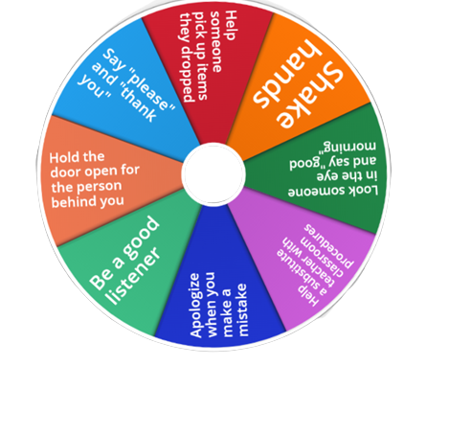
Spin the wheel to identify ways to show courtesy for others.

Slide 7
Scenarios
What should you do?

Slide 8
How can you show courtesy?
There is a new student in your class. She seems nervous.

Slide 9
How can you show courtesy?
A student in your class drops their lunch on the ground.

Slide 10
How can you show courtesy?
Your teacher is teaching a writing lesson.

Slide 11
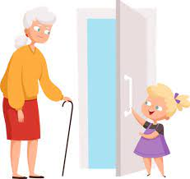
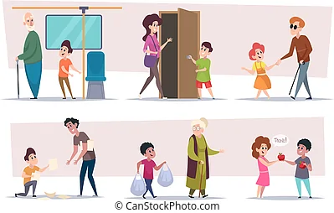
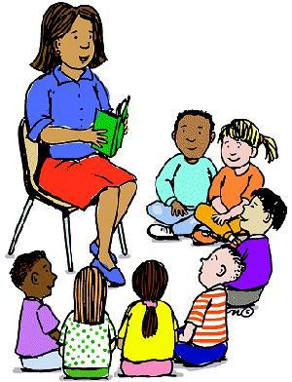
What Courtesy Looks Like

Slide 12
Home Activity: I will show courtesy
I will….
Listen to others
Ask how I can help
Say please and thank you
Be polite to others
Be mindful

