Slide 1
Title IX Sexual Harassment
Role Title IX Appeal Officer Presentation
Legal Services Office, Cypress-Fairbanks ISD
2022-2023
Information derived from Thompson & Horton “New Title IX Regulations” and “Title IX Investigations” Webinars and TASB “Title IX: What’s New?” PowerPoint Presentation

Slide 2
Title IX Overview
Title IX is a statute Congress passed in 1972 to prohibit sex discrimination in educational institutions and provide remedies against such discrimination.
Title IX protects students and employees from discrimination on the basis of sex in their education programs and activities, including sexual harassment.
In 2020, the U.S. Department of Education released new regulations under Title IX that dictated specific procedures on how schools must respond to sexual harassment complaints.
Notes:
Title IX is federal statute that protects students and employees from discrimination on the basis of sex in their education programs and activities, including sexual harassment
In 2020 the Department of Education issued new regulations that dictate how schools must respond to sexual harassment.

Slide 3
Overview of Regulations
Require defined roles for staff:
Title IX coordinator, investigator,
decisionmaker, informal resolution facilitator, hearing advisor, and appeal officer
Create new terms for the parties. Complainant-an individual who is alleged to be the victim of conduct that could constitute sexual harassment. Respondent-an individual who has been reported to be the perpetrator of conduct that could constitute sexual harassment.
Recipient-school districts/schools
Also require that any individual involved in the Title IX processit:
not have a conflict of interest or bias for or against complainants or respondents generally or an individual complainant or respondent
avoid prejudgment of the facts
Notes:
The new regulations created various roles for staff members who are tasked with responding to claims of sexual harassment. Specifically, the new regulations require the following roles: Title IX coordinator, investigator, decisionmaker, informal resolution facilitator, hearing advisor, and appeal officer.
Further, under the new regulations, alleged victims of sexual harassment are referred to as complainants, alleged perpetrators are referred to as respondents, and school districts are referred to as recipients.
The regulations also require that any staff members involved in the Title IX process not have any conflict of interests or bias for or against any individual complainant or respondent or complainants or respondents generally as a group, and that staff members also avoid prejudgment of the facts.

Slide 4
Schools Resposne Obligations
A school must respond when it has:
Actual knowledge
Of sexual harassment
That occurred within the school’s education program or activity
Against a person in the US
A school has actual knowledge when:
ANY employee of an elementary or secondary school has notice of sexual harassment or allegations of sexual harassment
Includes teachers, teacher’s aide, bus drivers, cafeteria workers, counselors, school resource officers, maintenance staff worker, etc.
A school’s education programs or activities include any events, or circumstances over which the school exercised substantial control over both
the respondent; and
the context in which the sexual harassment occurs
Notes:
A school is required to respond under Title IX when it has actual knowledge of sexual harassment that occurred within the schools education program against a person in the US.
A school has actual knowledge when any employee of an elementary or secondary school has notice of sexual harassment or allegations of sexual harassment.

Slide 5
Sexual Harassment
Sexual Harassment
means conduct on
the basis of sex that
satisfies one or more of the following categories:
01
Quid Pro Quo
02
Hostile Environment
03
Sexual Assault, Dating Violence, Domestic Violence, or Stalking
Notes:
There are three categories of conduct which constitute sexual harassment under Title IX:
Quid Pro Quo
Hostile Environment
Sexual assault, dating violence, domestic violence, or stalking
Quid Pro Quo sexual harassment occurs when a school employee conditions an educational benefit on participation in unwelcome sexual conduct
Hostile Environment is defined as unwelcome conduct that a reasonable person would determine is so severe, pervasive, and objectively offensive that it effectively denies a person equal access to the school’s education program or activity.
It should be noted that a hostile environment can not only be created students or school employees, but it can also be created or someone visiting the school, such as an employee from another school or from an outside contractor.
Additionally, sexual assault, dating violence, domestic violence and stalking are all also considered sexual harassment under Title IX.

Slide 6
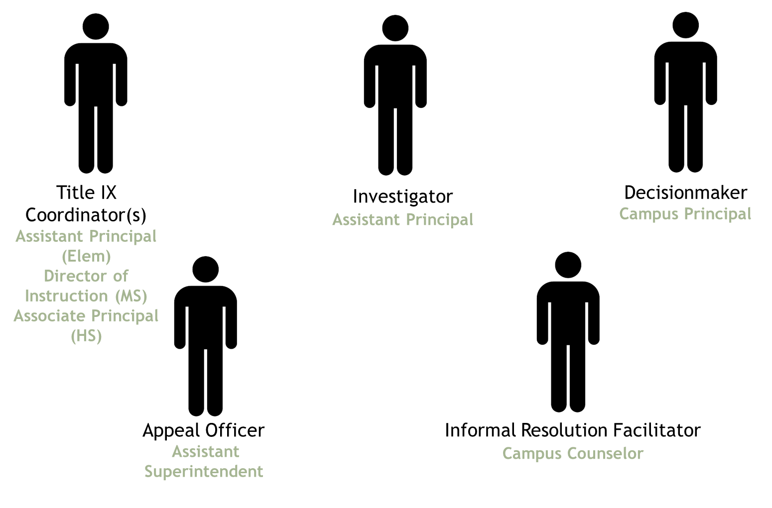
Title IX Personal Assignments in CFISD
Notes:
As previously discussed, the new regulations created various roles for staff members who are tasked with responding to claims of sexual harassment. In CFISD the Campus Title IX Coordinator role will be performed by Assistant Principal at the elementary school level, the Director of Instruction at the middle school level, and the Associate Principal at the high school level.
The Investigator role will be performed by the Assistant Principal. The Decisionmaker role will be performed by the Campus Principal. The Appeal Officer Role will be performed by an Assistant Superintendent. Finally, the Informal Resolution Facilitator role will be performed by a Campus Counselor.

Slide 7
Basic Title IX Process
Campus Title IX Coordinator
Campus Title IX Coordinator
Campus Title IX Coordinator
Knowledge of Allegations of Title IX Sexual Harassment
Title IX Coordinator Reaches out to Complainant
Determination of Supportive Measures
Determination of Emergency Removal
Investigator
Campus Title IX Coordinator
Campus Title IX Coordinator
Investigation
Dismissal Evaluation
Notice of Formal Complaint
Formal Complaint
Written Investigation Report
Parties may Submit Written Questions and Respond to Investigation Report
Written Determination
Appeal
Investigator
Decisionmaker
Decisionmaker
Appeal Officer
Notes:
As detailed by the Title IX Process flowchart, when campus staff gain knowledge of possible allegations of Title IX sexual harassment the Campus Title IX Coordinator must reach out to complainant, make a determination regarding possible supportive measures, and make a determination as to whether an emergency removal is necessary. If a formal complaint is ultimately filed the Campus Title IX Coordinator must provide notice of the formal complaint to the parties. After providing the parties with notice of the complaint the Campus Title IX Coordinator must make a determination as to whether the complaint is subject to dismissal. If the complaint is not dismissed,. The Investigator will then proceed with the investigation and ultimately generate a written report. Next, the Decisionmaker is required to oversee a process where parties may submit questions to each other and submit a response to the investigation report before ultimately issuing a written determination. Finally, the parties may have right to submit an appeal of a complaint dismissal or written determination to the Appeal Officer.

Slide 8
The Formal Complaint Process Requirements
3 Remedies
Remedies are required to be provided to a complainant when a respondent is found responsible, and they must be designed to maintain the complainant’s equal access to education.
Possible remedies a school may provide a complainant and disciplinary sanctions a school might impose on a respondent following a determination include:
Examples of remedies:
counseling
course-related adjustments
modifications of work or class schedules
campus escort services
increased security and monitoring of certain areas of campus
mutual restrictions on contact between the parties
Example of disciplinary sanctions:
removal from a regular classroom or campus
out-of-school suspension
placement in a disciplinary alternative education program
expulsion from school
1 Objective Evaluation
Objective evaluation of all relevant evidence, inculpatory and exculpatory, and avoids credibility determinations based on a person’s status as a complainant, respondent, or witness. The formal complaint process should operate under the assumption that the respondent is not responsible for the alleged conduct until a determination regarding responsibility is made at the conclusion of the formal complaint process.
2 Prompt Time Frame
Reasonably prompt time frame for its conclusion, including for appeals, with allowance for short-term, good cause delays, or extensions of the time frames.
Good time delay includes concurrent law enforcement activity, the absence of a party or witness, the absence of a party’s advisor of choice, or the need for language assistance or accommodation of disabilities.
Notes:
The formal complaint process must be a consistent, transparent process for resolving formal complaints of sexual harassment, and all relevant evidence should be evaluated objectively. Credibility determinations based on a person’s status as a complainant, respondent, or witness should be avoided. The formal complaint process should operate under the presumption that the respondent is innocent until a determination regarding responsibility is made.
The formal complaint process must have reasonable time frame for its conclusion, with allowance for short-term, good cause delays, or extensions of the time frames. Under the District’s formal complaint procedures a determination of responsibility is required to be issued within 45 District business of the filing or signing of a formal complaint absent good cause for delay.
Remedies are required to be provided to a complainant when a respondent is found responsible, and they must be designed to maintain the complainant’s equal access to education and may include individualized services and/or disciplinary sanctions that serve as punishment, they need not avoid burdening the respondent.
Examples of remedies may be similar to those listed for supportive measures such as counseling, course-related adjustments, modifications of work or class schedules, campus escort services, increased security and monitoring of certain areas of campus, and mutual restrictions on contact between the parties. Examples of disciplinary sanctions may include removal from a regular classroom or campus, out-of-school suspension, placement in a disciplinary alternative education program, or expulsion from school.

Slide 9
Hearing Advisor Role
If a party elects to use a hearing advisor, the advisor:
may be present during interviews and meetings
may review evidence and reports from investigation process
may be present for the written hearing process.
may be friends, family members, attorneys, or other individuals with whom the party has a trusted relationship
Note: The district is not responsible for providing or training hearing advisors.
Notes:
If a party elects to use a hearing advisor, their advisor may be present during interviews and meetings, must be allowed to review evidence and reports from investigation process, and may be present for the written hearing process.
A party’s hearing advisor may be a friend, family member, attorney, or other individual with whom the party has a trusted relationship.
Further, the district is not responsible for providing or training hearing advisors.

Slide 10
Formal Complaint Process: Investigation Evidence
EVIDENCE REQUIREMENTS
STANDARD OF EVIDENCE
Burden of gathering evidence and burden of proof must remain on schools
All evidence must be objectively evaluated
Confidentiality should be maintained to the greatest extent possible
Parties’ attorney-client communications and medical psychological information are protected by legal privilege and the school cannot access or use such records unless the school obtains the party’s voluntary, written consent to do so
Investigator must provide equal opportunity for the parties to present fact and expert witnesses and other inculpatory and exculpatory evidence
Investigator must not restrict the ability of the parties to discuss the allegations or gather evidence (e.g., no “gag orders”)
Evidence is relevant if: (a) it has any tendency to make a fact more or less probable than it would be without the evidence, and; (b) the fact is of consequence in determining the action.
Rape Shield – Evidence about a complainant’s prior sexual behavior is irrelevant during the entire formal complaint process unless:
Offered to prove that someone other than the respondent committed the alleged misconduct
Offered to prove consent
The law gives school districts the choice between the preponderance of the evidence standard and clear and convincing evidence standard.
The preponderance of the evidence standard is understood to mean concluding that a fact is more likely than not to be true. Under this standard if at least 51% of the evidence favors the complainant, then the respondent will be found responsible.
A clear and convincing evidence standard is more rigorous, understood to mean that a fact is highly probable to be true.
In CFISD, we have adopted the preponderance of the evidence standard
This standard must be used for all complaints against students and employees.
Notes:
During the formal complaint process the school has the burden of gathering evidence and the burden of proof, and is required to evaluate all evidence objectively. Further, Investigators must provide parties with an equal opportunity to submit evidence.
Evidence is relevant if: (a) it has any tendency to make a fact more or less probable than it would be without the evidence, and; (b) the fact is of consequence in determining the action.
Investigators must not restrict the ability of the parties to discuss the allegations or gather evidence. As such, Investigators may not put in place gag orders which prohibit the parties from communicating with witnesses or others.
The Attorney-client communications, medical information, and psychological information of each party is protected by legal privilege and cannot be accessed or used by the school unless the school obtains the party’s voluntary, written consent to do so
Additionally, evidence about a complainant’s prior sexual behavior is irrelevant during the entire formal complaint process unless it is offered to prove that someone other than the respondent committed the alleged misconduct or offered to prove consent.
Further, the law gives school districts the choice between using a preponderance of the evidence standard and a clear and convincing evidence standard. The District has adopted the preponderance of the evidence standard. The preponderance of the evidence standard is understood to mean concluding that a fact is more likely than not to be true. If at least 51% of the evidence favors the Complainant, then the Respondent will be found responsible. If the evidence does not meet that threshold, the Respondent is not responsible. This standard must be used for all complaints against students and employees.

Slide 11
Appeals
The parties may appeal a written determination of responsibility or dismissal of a formal complaint on the following basis:
Procedural irregularity that affected the outcome of the matter,
Newly discovered evidence that could affect the outcome of the matter, and/or
Title IX personnel had a conflict of interest or bias that affected the outcome of the matter
Either party may appeal by submitting Title IX Appeal Form to Campus Title IX Coordinator.
If the reason for appealing the dismissal or determination of responsibility is not one of the permitted bases for appeal, the Title IX Coordinator may dismiss the appeal.
If the request for an appeal is not dismissed, the Title IX Coordinator will assign an Appeal Officer to proceed.
The Appeal Officer may not be the Campus Title IX Coordinator, Investigator or Decision maker
The determination of the Appeal Officer is final.
Notes:
Either party may appeal a written determination of responsibility or dismissal of a formal complaint on the basis of a procedural irregularity that affected the outcome of the matter, on the basis of newly discovered evidence that could affect the outcome of the matter, and/or based on claims that Title IX personnel had a conflict of interest or bias that affected the outcome of the matter
In order to appeal the parties must submit a Title IX Appeal Form to Campus Title IX Coordinator.
The Title IX Coordinator may dismiss the appeal if the reason for appealing the dismissal or the determination of responsibility is not one of the permitted bases for appeal
However, if the request for an appeal is not dismissed, the Campus Title IX Coordinator will assign an Appeal Officer to proceed, and the Appeal Officer may not be the Campus Title IX Coordinator, Investigator or Decisionmaker. The Appeal Officer’s determination is final.

Slide 12
Appeal Officer Role/ Appeal Process
Issue notice of appeal to both parties
Give both parties a reasonable, equal opportunity to submit a written statement in support of, or challenging the outcome
Review appeal form and appeal statements
Evaluate the evidence and outcome
Issue a written decision including:
Result of the appeal
Rationale for the result
Provide the written decision simultaneously to both parties and Title IX Coordinator
Notes:
As part of the appeal process the Appeal Officer is required to first issue a notice of the appeal to both parties and give them each an opportunity to submit a written statement in support of or challenging the outcome. Next the Appeal Officer must review appeal form and appeal statements, evaluate the evidence and outcome, and ultimately issue a written decision.
The written decision must be simultaneously provided to both parties and the Title IX Coordinator, and include the result of the appeal and the rationale for the result.

Slide 13
Appeal Decision
After consideration of the appeal the Appeal Officer may either uphold or overturn a dismissal of a formal complaint or Title IX Decision Determination.
A decision to uphold a dismissal or a determination concludes the formal complaint process.
If a dismissal or determination is overturned, the Appeal Officer will give a direction to return to the Title IX Formal Complaint process and explain what steps need to be taken to correct the issue.
Notes:
The Appeal Officer’s written decision may either uphold or overturn a dismissal of a formal complaint or Title IX Decision Determination.
A decision to uphold a dismissal or a determination concludes the formal complaint process.
If a dismissal or determination is overturned, the Appeal Officer must give a direction to return to the Title IX Formal Complaint process and explain what steps need to be taken to correct the issue that was the subject of the appeal

Slide 14
RETALIATION STRICTLY PROHIBITED
New regulations contain an anti-retaliation provision.
Charges of code of conduct violations that arise out of the same facts or circumstances as a report of sex discrimination or sexual harassment for the purpose of interfering with any right under Title IX constitutes retaliation.
Charges for making a materially false statement is not retaliation if charge is not based solely on outcome of the formal complaint process.
Complaints regarding retaliation may be filed in accordance with the District’s Title IX formal complaint process.
Notes:
Retaliation is expressly prohibited under the regulations. No school or person may intimidate, threaten, coerce, or discriminate against any individual for the purpose of interfering with any right or privilege secured by Title IX, or because the individual has made a report or complaint, testified, assisted, or participated or refused to participate in any manner in a Title IX investigation or proceeding. Further, charging a student with code of conduct violations that arise out of the same facts or circumstances as a report or formal complaint of sexual harassment for the purpose of interfering with any right or privilege secured by Title IX constitutes retaliation.
Complaints alleging retaliation may be filed according to a District’s Title IX formal complaint process.

Slide 15
Record Keeping
Must maintain for a period of seven years records of—
Final determination
Any audio or audiovisual recording or transcript
Any disciplinary sanctions imposed on the respondent
Any remedies provided to the complainant designed to restore or preserve equal access to the recipient's education program or activity;
Any supportive measures taken or the reason for no supportive measures
Any appeal and the result
Any informal resolution and the result; and
All materials used to train Title IX Personnel
Must document the basis for conclusions reflecting that the district’s response was not deliberately indifferent
Must document measures designed and taken to restore or preserve equal access to the recipient's education program or activity.
.
Notes:
Pursuant to the regulations, the District is required to maintain records of the final determination, any audio or audiovisual recording or transcript, any disciplinary sanctions imposed on the respondent, any remedies provided to the complainant, any supportive measures taken or the reason for no supportive measures, any appeal and the result therefrom, any informal resolution and the result therefrom, and all materials used to train Title IX Personnel for a period of seven years.

Slide 16
THANK YOU!

